Slide 1

C++: Pointers & Strings
Presenter: Dr. Ha Viet Uyen Synh.

Slide 2

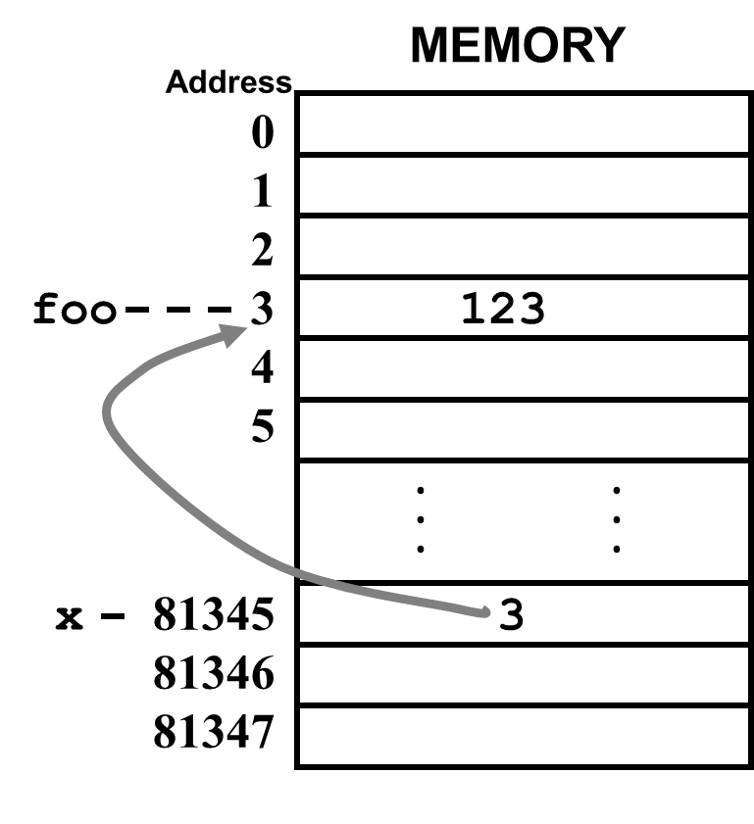
Pointer
A pointer is a variable that holds the address of something else.
“&” operator gets the address of a variable.
“*” operator gets a value of a pointer
int foo;
int *x;
foo = 123;
x = &foo;
foo = foo + 5;
// *x = *x+5;

Slide 3
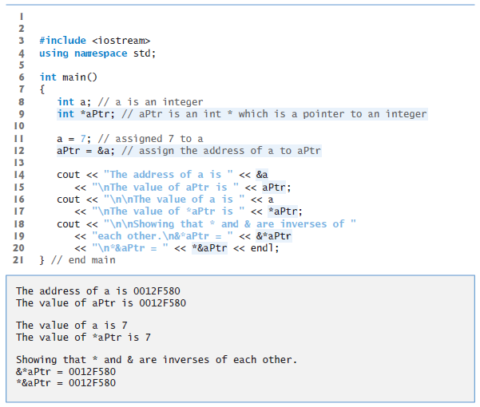
Example

Slide 4
Assigning a value to a dereferenced pointer
A pointer must have a value before you can dereference it (follow the pointer).
int *x;
*x=3;
int foo;
int *x;
x = &foo;
*x=3;
ERROR!!!
x doesn’t point to anything!!!
this is fine
x points to foo

Slide 5
Pointers to anything
x
some int
int *x;
int **y;
double *z;
y
some *int
some int
z
some double

Slide 6
Pointers and Arrays
An array name is basically a const pointer.
You can use the [] operator with a pointer:
int *x;
int a[10];
x = &a[2];
for (int i=0;i<3;i++)
x[i]= x[i]+1;
x is “the address of a[2] ”
x[i] is the same as a[i+2]

Slide 7
Pointer arithmetic
Integer math operations can be used with pointers.
If you increment a pointer, it will be increased by the size of whatever it points to.
int *ptr = a;
*(ptr+2)
*(ptr+4)
*ptr
a[0] a[1] a[2] a[3] a[4]
int a[5];

Slide 8
Printing an array
void print_array(int a[], int len) {
for (int i=0;i<len;i++)
cout << "[" << i << "] = "
<< a[i] << endl;
}
array version
void print_array(int *a, int len) {
for (int i=0;i<len;i++)
cout << "[" << i << "] = "
<< *a++ << endl;
}
pointer version

Slide 9

String
A string is a null terminated array of characters.
null terminated means there is a character at the end of the the array that has the value 0 (null).
Pointers are often used with strings:
char *msg = “RPI”;
char msg2[] = “RPI”;
char msg3[] = {‘R’,’P’,’I’,0};
zero (null)
msg
'R'
'P'
'I'
0

Slide 10
Arrays of Pointers
const char * const suit[ 4 ] = { "Hearts", "Diamonds", "Clubs", "Spades" };

Slide 11

Function
Readability: sqrt(5) is clearer than copy-pasting in an algorithm to compute the square root
Maintainability: To change the algorithm, just change the function (vs changing it everywhere you ever used it)
Code reuse: Lets other people use algorithms you’ve implemented
Function declarations need to occur before invocations

Slide 12
Syntax
Return type
parameters
Function name
int add2ints(int a, int b) {
return(a+b);
}
Function body

Slide 13
Function parameters
The parameters are local variables inside the body of the function.
When the function is called they will have the values passed in.
The function gets a copy of the values passed in (we will later see how to pass a reference to a variable).

Slide 14
Example
int add2nums( int firstnum, int secondnum ) {
int sum;
sum = firstnum + secondnum;
// just to make a point
firstnum = 0;
secondnum = 0;
return(sum);
}
int main(void) {
int y,a,b;
cout << "Enter 2 numbers\n";
cin >> a >> b;
y = add2nums(a,b);
cout << "a is " << a << endl;
cout << "b is " << b << endl;
cout << "y is " << y << endl;
return(0);
}

Slide 15
Local & Global variables
Parameters and variables declared inside the definition of a function are local.
They only exist inside the function body.
Once the function returns, the variables no longer exist!
You can declare variables outside of any function definition – these variables are global variables.
Any function can access/change global variables.

Slide 16
References
A reference variable is an alternative name for a variable.
A reference variable must be initialized to reference another variable.
Once the reference is initialized you can treat it just like any other variable.
To declare a reference variable you precede the variable name with a “&”:
int &foo;
char &c;
int count;
int &blah = count;

Slide 17
Example
void add10( int &x) {
x = x+10;
}
…
add10(counter);
void swap( int &x, int &y) {
int tmp;
tmp = x;
x = y;
y = tmp;
}
The parameter is a reference

Slide 18

Any question?

Slide 19
Exercise 1
Write a function that prints a triangle
triangle(4); triangle(5);
* *
*** ***
***** *****
******* *******
*********

Slide 20
Exercise 2
Write a strcpy function that copys a string to another one.
Write a strcmp function that compares 2 strings and returns true if they are the same string, false if they are not.
Write a strspc function that removes all spaces from a string.

Slide 21
Exercise 3
(Square of Asterisks) Write a function that displays at the left margin of the screen a solid square of asterisks whose side is specified in integer parameter side. For example, if side is 4, the function displays the following:
* * * *
* * * *
* * * *
* * * *
(Square of Any Character) Modify the function created to form the square out of whatever character inputted from keyboard.

Slide 22
Exercise 4
Write a program that inputs three double-precision, floating-point numbers and passes them to a function that returns the smallest number.

Slide 23
Exercise 5
(Perfect Numbers) An integer is said to be a perfect number if the sum of its divisors, including 1 (but not the number itself), is equal to the number. For example, 6 is a perfect number, because 6 = 1 + 2 + 3. Write a function isPerfect that determines whether parameter number is a perfect number. Use this function in a program that determines and prints all the perfect numbers between 1 and 1000. Print the divisors of each perfect number to confirm that the number is indeed

Slide 24
Exercise 6
Write a function that prints a character 8
char8(5);
* * * * *
* *
* * * * *
* *
* * * * *

Slide 25
Exercise 7
Write a function that prints a solid inverse triangle
solinvtriangle(4);
*******
*****
***
*
Write a function that prints an inverse triangle
invtriangle(4);
*******
* *
* *
*

Slide 26
Exercise 8
Write a program to pass in a integer number. Output 2 numbers: one number includes the odd position number characters, another includes the even position number characters. Calculate the total of the two numbers.
Ex:
Input: 245387
Output: 258 and 437
Total: 695

Slide 27

Any Questions?
 hvusynh@hcmiu.edu.vn

Slide 28
Quiz #4
(Prime Numbers) An integer is said to be prime if it’s divisible by only 1 and itself. For example, 2, 3, 5 and 7 are prime, but 4, 6, 8 and 9 are not.
a) Write a function that determines whether a number is prime.
b) Use this function in a program that determines and prints all the prime numbers between 2 and 10,000. How many of these numbers do you really have to test before being sure that you’ve found all the primes?
c) Initially, you might think that n/2 is the upper limit for which you must test to see whether a number is prime, but you need only go as high as the square root of n. Why? Rewrite the program, and run it both ways. Estimate the performance improvement.

